Slide 1
Team: High flyers
Russ McGrath
Sharmila Sainani
Alexandra Zelcer
Tony Joy

Slide 2
United States Live Wild Fire Analysis

Slide 3
Link to the project Heroku hosting

Slide 4
ETL Process
Extract
Transform
Load

Slide 5
Data Extraction
Source:
National Wildfire Coordinating Group’s Incident Information System
https://inciweb.nwcg.gov/feeds/rss/incidents/
Parse RSS Feed (XML)
Digging Deeper
Reverse Geomapping
Parse the source page using Beautifle Soup with an XML parser
Determine the XML tag which represents each data “row”
Cycle through each instance of this tag and store the data in a series of list
Convert lists into a Pandas dataframe
Visit incident page for each fire
Grab the data tables, using Pandas read_html
Extract cause and size data from the tables
Feed lat/lon coordinates for each fire into Google’s Geomapping API to determine which state the fire is located in
(Used in generating choropleth map)
Result: Complete Data (Pandas Dataframe)

Slide 6
Data Transformation
Consolidate Fire Causes
Strip Fire Acreage Value
Handle data gaps
Unknown
Under Investigation
Investigating
Unknown / Under Investigation
“Unknown”
“Under Investigation”
“Investigating”
“Unknown/Under Investigation”
“213,945 Acres”
[no data]
“Unknown”
“213,945”
“n/a”
Result: Clean Data (Pandas Dataframe)

Slide 7

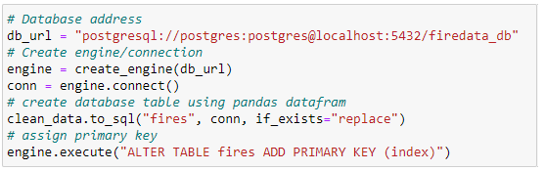


Data Loading
Result: postgresql Database

Slide 8
Marker Map Heat Map Choropleth Map

Slide 9
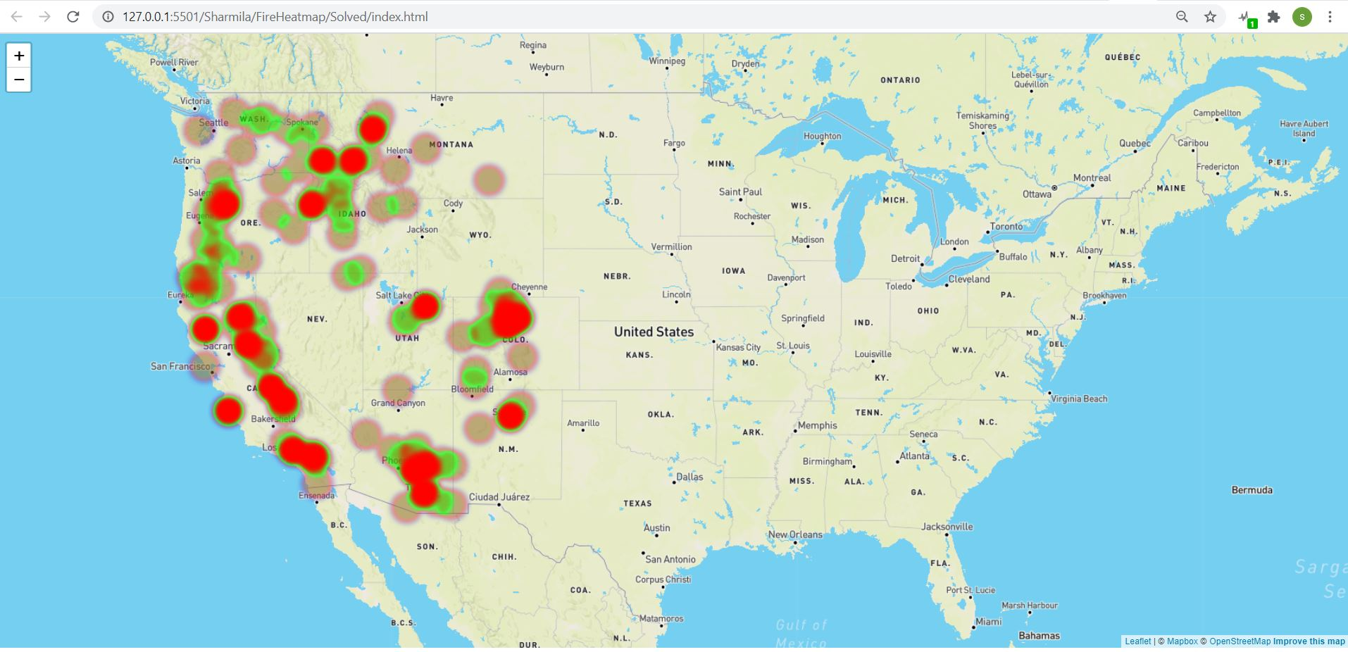
Heat map
In this heatmap data visualization the range of colors represent the density of points in a particular area.
2) This map helps us see the “shape” of the data and highlight areas of concentration where many points are clustered closely together.

Slide 10
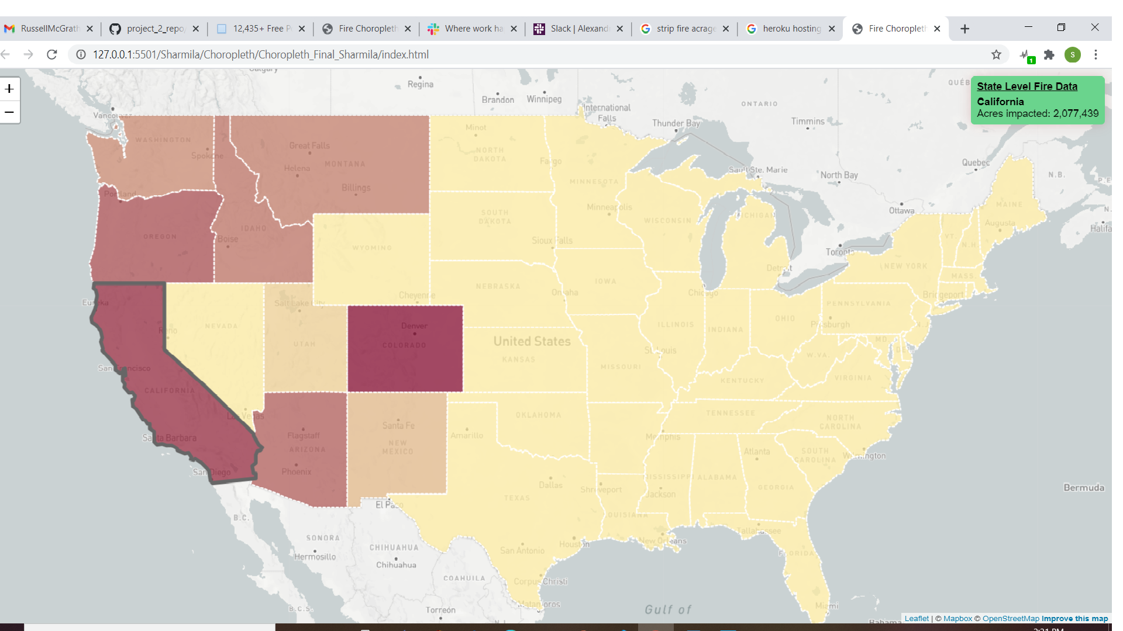
Choropleth Map
1)In this choropleth map we visualize the state level data.
2) By hovering over the state map you can see the total acers burned.

Slide 11
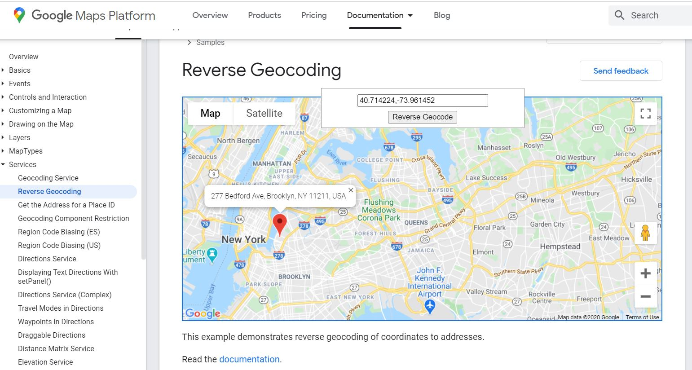
Reverse Geocoding
Feed the latitude and longitude coordinates for each fire into Google’s Geocode API to extract the complete data relating to the given coordinates and extracting the state info for the coordinates with fire data

Slide 12
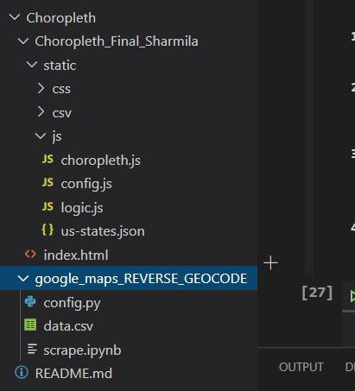
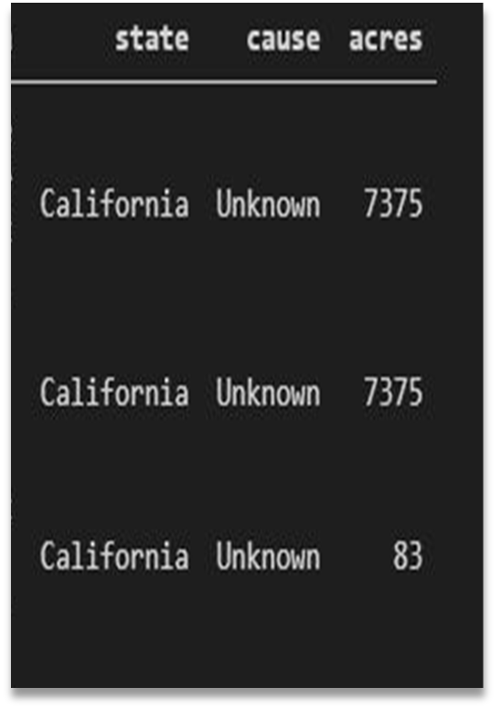
Files required columns generated
1) For this choropleth map we have used the additional file
US-States.json
2) Calculated the total acers burned in the state and added in Acers
column
3) Sate column being added

Slide 13
Challenges conquered
Adding required columns determining state based on Latitude and longitude date
2) Heat map result (beginner problem)

Slide 14
If we had more time
Technical:
Pixijs 2D java script library
Authentication
Mango DB
SQLite file
Informational:
Temperature Analysis
Air quality Analysis
Fire fighters resources Availability Analysis

Slide 15
Thank you
For your time
From Team: High Flyers

